Slide 1

CS 484 Intro to Machine Learning
Week 1
August 26, 2020

Slide 2
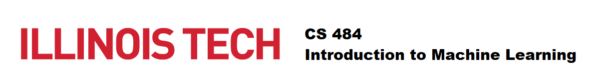
About the Instructor: Ming-Long Lam
Twenty-eight years of experience in practicing data science for:
Predictive analytics software development
Property and casualty insurance ratemaking
Human resources analytics for retail banking service
Passion and expertise
Develop analytics algorithms that enable machines to learn
Educate humans to mine data for insights
Develop commercial analytics software
Ph.D. in Statistics from The University of Chicago
Currently a Principal Research Statistician Developer of the SAS Institute, Cary, North Carolina
Previously held senior R&D technical positions in Chase, Allstate, and SPSS
ResearchGate profile: https://www.researchgate.net/profile/Ming_Long_Lam
LinkedIn profile: https://www.linkedin.com/pub/ming-long-lam/10/a73/657

Slide 3
About the Instructor
Virtual Office Hour
Platform and Time: To Be Determined
E-mail Policy
Email: mlam5@iit.edu
Will respond within 48 hours

Slide 4
About Teaching Assistant
To Be Announced …

Slide 5
Week 1 Agenda
Syllabus
What is Machine Learning?

Slide 6
What is this Course?
This is a Survey Course
We will
Learn the primary topics of a broad field of knowledge
Understand the main machine learning algorithms in each topic
Develop computer codes to implement or exercise these algorithms
We won’t
Visit every machine learning topics (new ideas are constantly introduced)
Go through every algorithm in each topic
Teach basic Calculus and Probability (you need to refresh these topics)

Slide 7
Syllabus: Course Schedule
Introduction
Unsupervised Learning
Non-parametric Methods*
Bayesian Decision Theory
Clustering*
Supervised Learning
Decision Trees
Multinomial Logistic Regression*
Learner Evaluation and Comparison
Advanced Topics
Feature Selection
Naïve Bayes
Neural Networks*
Support Vector Machines
Bagging, Adaptive Boosting*
Gradient Boosting
* Assignment Week

Slide 8
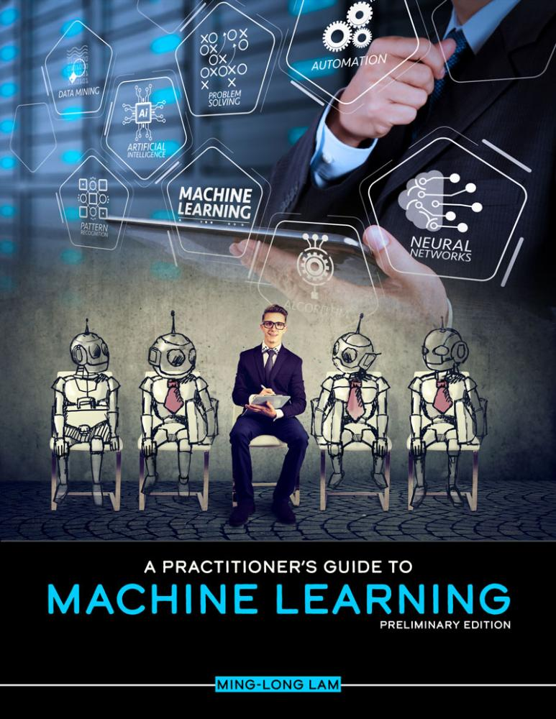


Syllabus: Textbook and Software
Ming-Long Lam (2020). A Practitioner's Guide to Machine Learning, Kendall Hunt Publishing
https://he.kendallhunt.com/product/practitioners-guide-machine-learning
Python 3.7.7 (May 6, 2020)
Scikit-learn 0.23
Platform of your choice (Windows, macOS, or Linux)
Required for completing your programming assignments
I developed Python codes in the Spyder environment

Slide 9
Syllabus: Evaluation and Grade
Evaluation:
50% Assignments
25% Mid-Term Test
25% Final Exam
Letter Grade:
A | Excellent | 90% and above
B | Average | 75% and less than 90%
C | Passed | 60% and less than 75%
E | Failed | Less than 60%

Slide 10
Syllabus: Assignments
Five assignments will be given on
Week 2: September 2, Week 4: September 16, Week 6: September 30, Week 10: October 28, and Week 12: November 11
Each assignment’s grade count towards 10% of your course grade
Please type your assignment as PDF documents
Maximum points for each assignment is 100 points
Please submit your assignment to the Blackboard site before the due date
Due date is the end of the next class day
For example, the September 2 assignment is due at 11:59 pm on September 9.
Whenever necessary, properly documented and error-free Python program codes and output should be included your submission

Slide 11
Syllabus: Assignments – Late Work Policy
If you turn in an assignment late, then we have the right to deduct 5 points from the total score for each 24-hour period after the deadline.
Assignments turned in more than 7 days late will not receive credit.
In the case of unexpected events (e.g., sickness and emergency), you must contact the instructor and explain your situation before the assignment due date in order to receive a grace period.

Slide 12
Syllabus: Mid-Term Test and Final Exam
Take-Home Mid-Term Test
Given on Week 8, October 14, 2020
Account for 25% of your final course grade
Take-Home Final Exam
Given in the Final Exam Week
Account for 25% of your final course grade

Slide 13
Quick Straw Poll
Have you taken any …
Statistics courses (e.g., Regression)?
Do you have experiences in …
Statistical software (e.g., SAS, SPSS, Stata, R)?
Programming languages (e.g., C/C++, Java, Python)?
Database software (e.g., SQL, Spark)?
Web development (e.g., HTML5)?
Do you have job experiences as …
Data Scientist?
Statistician?
Data Analysts?
Predictive Modelers?
Business Analysts?
Others?

Slide 14
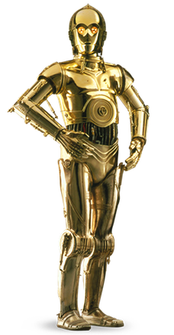
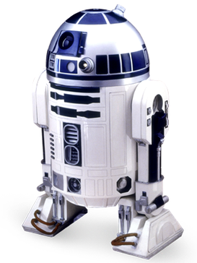
What is Machine Learning?
C-3PO is a master of natural language processing and he knows over six million forms of communication, including English, in the galaxy
R2-D2 analyzes a problem logically, learns from past experiences, selects the right tool for the problem, and courageously reach the solution.

Slide 15

What is Machine Learning?
The term Machine Learning was coined by Arthur L. Samuel (1901 – 1990) in his 1959 paper.
Received a master's degree in Electrical Engineering from MIT in 1926
Developed the first Checkers program on IBM's first commercial computer in 1952
Retired from IBM in 1966 and joined Stanford University as a professor
Worked on the TeX project around 1978
Arthur Samuel playing Checkers on the IBM 701 in 1956. Source: http://www-03.ibm.com/ibm/history/ibm100/us/en/icons/ibm700series/impacts/

Slide 16
Historical Definitions
A field of study that gives computers the ability to learn without being explicitly programmed. – Arthur L. Samuel (1959). "Some Studies in Machine Learning Using the Game of Checkers". IBM Journal of Research and Development.
A computer program is said to learn from experience E with respect to some task T and some performance measure P, if its performance on T, as measured by P, improves with experience E. – Tom Mitchell (1997). Machine Learning, New York: McGraw-Hill
Tom Mitchell (1951 – ), currently Professor, Computer Science Department, Carnegie Mellon University

Slide 17
Definitions in the Dictionary
Machine Learning is the process by which a computer is able to improve its own performance (as in analyzing image files) by continuously incorporating new data into an existing statistical model. — Merriam-Webster, https://www.merriam-webster.com/dictionary/machine%20learning
Machine learning, in artificial intelligence (a subject within computer science), is a discipline concerned with the implementation of computer software that can learn autonomously. – Britannica, https://www.britannica.com/technology/machine-learning

Slide 18
Definitions on the Internet
Machine learning is a subset of artificial intelligence in the field of computer science that often uses statistical techniques to give computers the ability to "learn" (i.e., progressively improve performance on a specific task) with data, without being explicitly programmed. – Wikipedia, https://en.wikipedia.org/wiki/Machine_learning

Slide 19
Definitions from Tech Company
A program or system that builds (trains) a predictive model from input data. The system uses the learned model to make useful predictions from new (never-before-seen) data drawn from the same distribution as the one used to train the model. Machine learning also refers to the field of study concerned with these programs or systems. – Google, https://developers.google.com/machine-learning/glossary/#m
Machine learning is a form of AI that enables a system to learn from data rather than through explicit programming. However, machine learning is not a simple process. As the algorithms ingest training data, it is then possible to produce more precise models based on that data. A machine-learning model is the output generated when you train your machine-learning algorithm with data. — IBM, https://www.ibm.com/analytics/machine-learning

Slide 20
Definitions from Tech Company
Machine learning (ML) is the process of using mathematical models of data to help a computer learn without direct instruction. It’s considered a subset of artificial intelligence (AI). Machine learning uses algorithms to identify patterns within data, and those patterns are then used to create a data model that can make predictions. With increased data and experience, the results of machine learning are more accurate — much like how humans improve with more practice. — Microsoft, https://azure.microsoft.com/en-us/overview/what-is-machine-learning-platform/
Machine learning is a method of data analysis that automates analytical model building. It is a branch of artificial intelligence based on the idea that systems can learn from data, identify patterns and make decisions with minimal human intervention. – SAS Institute, https://www.sas.com/en_us/insights/analytics/machine-learning.html#machine-learning-importance

Slide 21
Machine Learning (Tom Mitchell,1997)
A computer program is said to learn from experience E with respect to some task T and some performance measure P, if its performance on T, as measured by P, improves with experience E.
When a machine learns, it involves three components.
Experience – What does a machine learn from?
Task – What does a machine learn for?
Performance Measure – How well did a machine learn?

Slide 22
A Human Learning Activity
Actually, a human learning activity also contains these three components.
A person is said to learn from experience E with respect to some task T and some performance measure P, if its performance on T, as measured by P, improves with experience E.
A person learns to
EITHER do something better (i.e., improve benefits, accuracy, or profit)
OR avoid a mistake (i.e., reduce cost, error, or loss)

Slide 23
Three Components of a Learning Activity
For a student in this CS 484 course
Experience – lecture, textbook, assignments, tests, and exam
Task – learn various topics in machine learning
Performance Measure – Letter grade (A > B > C > E)
For a loan officer
Experience – historical data where 20% of loans have defaulted
Task – learn to identify loans whose default rates are substantially higher or lower than 20%
Performance Measure – misclassification rate which is the fraction of observations that are misclassified by your model, and lower is better

Slide 24

Before a Learning Activity
Before we dive into any learning activity,
Take a minute or two to ask yourself this question.
What is the primary motivation for this learning activity?
In other words, Why am I Learning This?
Some possible answers are:
Identify loans that have high likelihoods of default
Establish a profile of the most valuable customers
Estimate the current value of a real estate property
Study browsing history of users who eventually land on Amazon

Slide 25
The Loan Officer Learning Example
Experience tells us that 20% of loans have defaulted.
If we do not have access to the data (i.e., the experience), then we will say that the Loan Default probability is 0.2.
This is a One-Size-Fits-All solution.
Suppose we will declare (i.e., classify) a loan is going to default if its Loan Default probability is greater than or equal to p_{0.}
If p₀ ≤ 0.2, then all the loans will be classified as defaulted. As a result, 80% = (1 – 0.2 = 0.8) of the loans will be misclassified.
If p₀ > 0.2, then none of the loans will be classified as defaulted. As a result, 20% of loans will be misclassified.

Slide 26
The Loan Officer Learning Example
Experience tells us that 20% of loans have defaulted.
If we have access to the data (i.e., the experience), then we will divide the data into segments. The average Loan Default probabilities in some segments are higher than 0.2 and some are lower than 0.2. The data is in hmeq.csv.
We will use the Classification Tree algorithm to learn from the data. We will cover this popular algorithm in a few weeks. See the Python codes in Week 1 MyFirstDecisionTree.py.

Slide 27
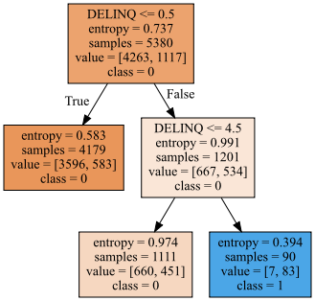
The Loan Officer Learning Example
The DELINQ variable is the number of credit inquiries (0, 1, …,15)
Value is the pair of [number of active loans, number of defaulted loans]
The training data contains 5,380 non-missing observations which have 1,117 defaulted loans. Thus, the default rate is 1117/5380 = 0.2076.

Slide 28
The Loan Officer Learning Example
There are 4,179 observations without any inquiries (i.e., DELINQ <= 0.5). The default rate is 583/4179 = 13.95%.
There are 1,201 observations which have at least one inquiry (i.e., DELINQ > 0.5). The default rate is 534/1201 = 44.46%.

Slide 29
The Loan Officer Learning Example
There are 1,111 observations which have 1, 2, 3 or 4 inquiries (i.e., 0.5 < DELINQ <= 4.5). The default rate is 451/1111 = 40.59%.
There are 90 observations which have at least five inquiries (i.e., DELINQ > 4.5). The default rate is 83/90 = 92.22%.

Slide 30
The Loan Officer Learning Example
After learning from the data, we came up with these rules.
If DELINQ = 0, then the predicted Default Likelihood = 13.95%.
If DELINQ = 1, 2, 3 or 4, then the predicted Default Likelihood = 40.59%.
If DELINQ > 4, then the predicted Default Likelihood = 92.22%.

Slide 31
The Loan Officer Learning Example
Suppose we will declare (i.e., classify) a loan is going to default if its Loan Default probability is greater than or equal to p_{0.}
If p₀ ≤ 0.1395, then all the loans → defaulted. The Misclassification Rate is 4263/5380 = 79.24%.
If 0.1395 < p₀ ≤ 0.4059, then the loans under Rule 2 and Rule 3 → defaulted. In other words, if DELINQ > 0 → defaulted. The Misclassification Rate is 23.23%.
If DELINQ = 0, then the predicted Default Likelihood = 13.95%.
If DELINQ = 1, 2, 3 or 4, then the predicted Default Likelihood = 40.59%.
If DELINQ > 4, then the predicted Default Likelihood = 92.22%.

Slide 32
The Loan Officer Learning Example
If 0.4059 < p₀ ≤ 0. 9222, then the loans under Rule 3 → defaulted. In other words, if DELINQ > 4 → defaulted. The Misclassification Rate is 19.35%.
If 0. 9222 < p₀, then all loans will be classified as non-default. The Misclassification Rate is 20.76%.
If DELINQ = 0, then the predicted Default Likelihood = 13.95%.
If DELINQ = 1, 2, 3 or 4, then the predicted Default Likelihood = 40.59%.
If DELINQ > 4, then the predicted Default Likelihood = 92.22%.

Slide 33
The Loan Officer Learning Example
Without learning from the experience (i.e., the data), the misclassification rate is either 80% or 20%.
After learning from the experience by using the classification tree algorithm, the misclassification rate is 79.24%, 23.23%, 19.35%, and 20.76%.
The benefits of performing this learning activity are:
We get away from the One-Size-Fits-All solution, have more risk levels for consideration even although we still cannot attain 0% misclassification rate.
We can identify a small segment of loans (DELINQ > 4 in 1.5% of the loans) which exhibit a very high default likelihood (92.22%). In other words, we have found a credible indicator of default for a loan.

Slide 34

After a Learning Activity
After we wrap up any learning activity,
Take a few minutes to answer this question.
What is the main outcome of this learning activity?
In other word, What Did I Learn?
Some possible answers are:
The most valuable customers bought something recently, very often, and expensive items.
I conclude that I cannot learn anything using the data that I have (e.g., all customers eventually bought something from Amazon)
If you cannot figure out what you’ve learned or cannot learn, then the learning activity is simply an activity for you to spend some time.

Slide 35
Follow-Up a Learning Activity
Reproducibility
If we start from the original data, use the same algorithms, execute the same tasks on the same or compatible machine, the machine learning activity will reproduce the same results (within the machine precisions) and arrive at the same conclusions.
If the expected results cannot be reproduced, this indicates there are some unexplained (intentional or random) interactions among the data, the algorithm, and the machine.
Common causes are uninitialized variables in the codes or incomplete or inaccurate documentation of the activity.
Take Note: if I cannot reproduce the expected results using your codes in your assignment, then I cannot award your points.

Slide 36
Follow-Up a Learning Activity
Replicability
If a researcher runs the machine learning activity (i.e., use the same algorithms, execute the same tasks) using a different data on some compatible machine, the researcher is able to obtain results that lead to the same conclusions (e.g., the list of selected features, the distribution of the predicted outcomes).
If the expected conclusions cannot be replicated, this indicates there are some design flaws in the tasks. For example, some correlations among the features are not accounted for, the algorithms need further tunings, additional tasks are required, or different algorithms should be considered.
Take Note: This is particularly imperative during the peer review process of your work (e.g., your dissertation).
We will come back to this topic when we talk about Learner Evaluation and Comparison

Slide 37
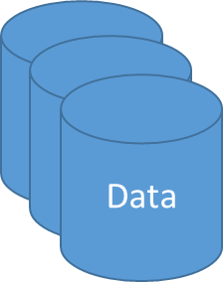
Machine Learning Life Cycle
Ask the Question
Specify What to Learn
Retrieve Data
Train Algorithms
Deploy Algorithm
Collect Feedback
Use Feedback
Depending on how autonomous the entire cycle is, some steps may require human intervention.
For example, the Ask the Question
A Self-Learner machine may perform all the steps provided a human has asked the initial question.

Slide 38
What ML Algorithm Should I Use?
It depends on many factors, including:
Technical Considerations –
The volume, the velocity, and the variety of data.
The quality (e.g., signal to noise) of data.
The available computational resources and time.
Business Considerations –
The nature of data (e.g., compliance of privacy regulation)
The urgency of the task.
The questions that you ask.

Slide 39
What ML Algorithm Should I Use?
An experienced data scientist will try multiple algorithms which are applicable to the question and then recommend an algorithm.
There are some guidelines on which algorithms to try first because those are the algorithms most people will try too.
It all depends on the question that you ask!

Slide 40
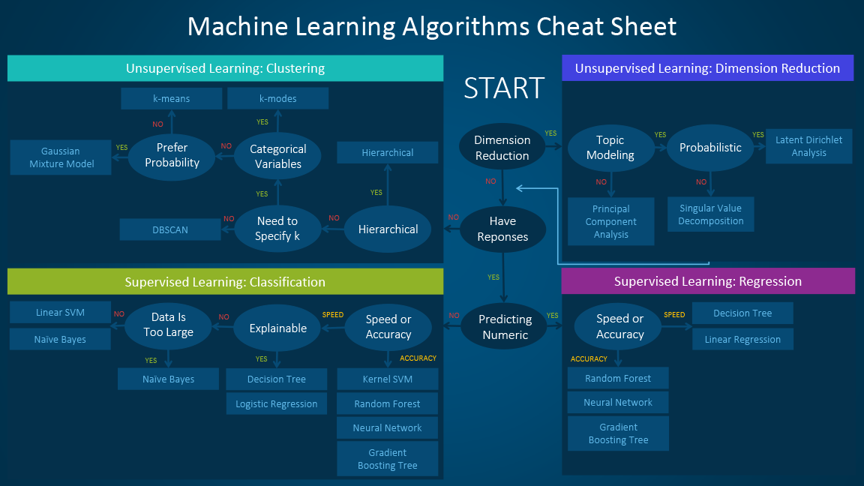
Source: https://blogs.sas.com/content/subconsciousmusings/2017/04/12/machine-learning-algorithm-use/

Slide 41
Types of Machine Learning Algorithms
Unsupervised Learning
No variables are designated as the label (a.k.a., the dependent, the response, or the target) variables.
Supervised Learning
Some variables are designated as the label variables. Some as the feature (a.k.a., the independent, or the predictor) variables.
Semi-supervised Learning
A type of supervised learning which use a relatively larger amount of unlabeled data (i.e., no label variable or missing label variables) to supplement the labeled data.
The goal is to improve the accuracy of supervised learning.

Slide 42
Types of Machine Learning Algorithms
Reinforcement Learning
A goal is defined with a reward function
The machine evaluates many What-If scenarios to discover which actions will yield the greatest reward.
Trial-and-error and delayed reward (e.g., the initial small loss is out-compensated by a later larger reward) distinguishes reinforcement learning from other techniques.
Adversarial Learning
Making machine learning algorithms robust against adversarial inputs.
Self Learning
Start with minimal or no historical data, and then output random actions.
Subsequently, observe the actual label or the actual reward.
Train on the ever-growing data to refine the action.

Slide 43
Brief Preview of Future Topics
Unsupervised Learning
Non-parametric Methods
Bayesian Decision Theory
Clustering
Supervised Learning
Decision Trees
Logistic Regression
Learner Evaluation and Comparison
Advanced Topics
Feature Selection
Naïve Bayes
Neural Networks
Support Vector Machines
Bagging and Adaptive Boosting
Gradient Boosting

Slide 44
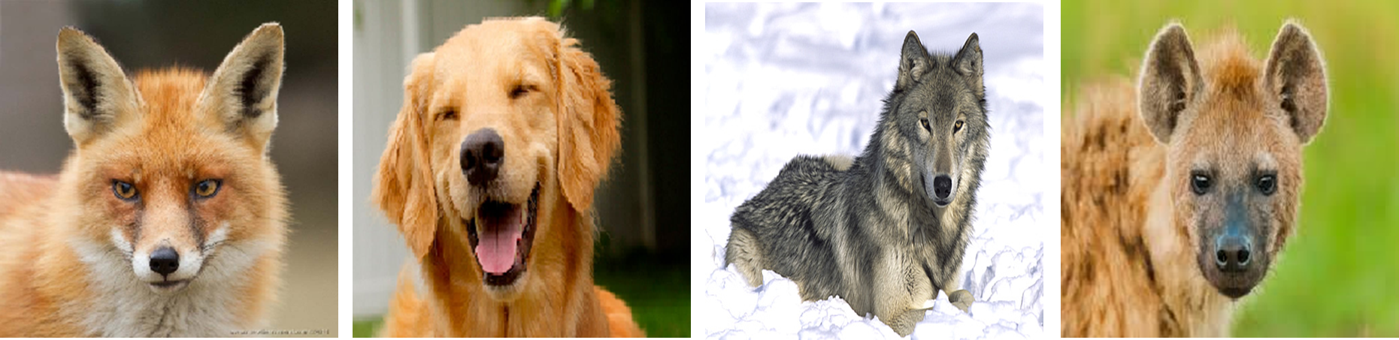
Non-parametric Methods
Chapter 2 of the course textbook
Density Estimation
Outlier Detection
Nearest Neighbors (a.k.a. Memory-Based Reasoning)
If a creature walks like a dog, looks like a dog, sits like a dog, and eats like a dog then it is probably a dog.
Well, it may not bark and be obedient as a dog.

Slide 45
Bayesian Decision Theory
Chapter 3 of the course textbook
Bayesian Decision Overview
Association Rules
80% of shoppers who buy ice-cream also purchase ice-cream cones.
When “do-it-yourselfers” buy latex paint, they also buy roller covers 85% of the time, but only 15% of time buys both roller frame and roller covers.

Slide 46
Clustering
Chapter 4 of the course textbook
K-Means Clustering
Observations in a cluster are assumed to have similar feature values.
Represent a cluster based on stereotypes (technically, the centroids).
Assign an observation to the “closest” cluster.
Determination of the number of clusters
This is a more difficult question to answer.
Special Clustering
Spectral Clustering

Slide 47
Clustering (A Over-Simplified Example)
Five observations in random order: 0.8, 0.3, 0.1, 0.4, and 0.9
Find the two clusters solution using the absolute difference distance
Cluster 1
Centroid C1 = 0.85
Distance from C1: 0.05, 0.55, 0.75, 0.45, and 0.05
Cluster 2
Centroid C2 = 0.2667
Distance from C2: 0.5333, 0.0333, 0.1667, 0.1333, and 0.6333
Cluster membership: 1, 2, 2, 2, 1

Slide 48
Decision Trees
Chapter 5 of the course textbook
Classification and Regression Tree (CART) algorithm
Use one variable at a time to sequentially partition observations into groups.
Classification tree for nominal label variable
Regression tree for interval label variable
Use the decision tree algorithm to generate the clusters’ profiles
Use the cluster identifier as the nominal label in a classification tree
These cluster profiles help us produce business descriptions of the clusters.

Slide 49
Decision Trees (The Loan Officer Example)
Decision Trees generate rules.
If DELINQ = 0, then the predicted Default Likelihood = 13.95%.
If DELINQ = 1, 2, 3 or 4, then the predicted Default Likelihood = 40.59%.
If DELINQ > 4, then the predicted Default Likelihood = 92.22%.

Slide 50
Logistic Regression
Chapter 6 of the course textbook
Binary or multinomial label variable
Given the values of the features, we can calculate the probability of this observation having a particular label value
The maximum likelihood estimation algorithm
An optimization algorithm where the likelihood is the objective value
Interpretation of parameter estimates or odds-ratios
Although not the primary concern in machine learning, these parameter estimates or odds-ratios enable us to detect some degenerated scenarios.

Slide 51
Logistic Regression Example
Predict Origin (Asia, Europe, or USA) by DriveTrain (All, Front, or Rear)
The observed counts and row percents are below:
At a glance, Front-wheel drive cars are mostly made in Asia, while Rear-wheel drive cars are mostly made in Europe.
Count | Origin
DriveTrain | Asia | Europe | USA | All
All | 34 | 36 | 22 | 92
Front | 99 | 37 | 90 | 226
Rear | 25 | 50 | 35 | 110
All | 158 | 123 | 147 | 428
Row % | Origin
DriveTrain | Asia | Europe | USA | All
All | 36.96% | 39.13% | 23.91% | 100%
Front | 43.81% | 16.37% | 39.82% | 100%
Rear | 22.73% | 45.45% | 31.82% | 100%
All | 36.92% | 28.74% | 34.35% | 100%

Slide 52
Logistic Regression Example
First Logit for Europe vs Asia:
DriveTrain=AWD: log_{e}(Pr(Europe)/Pr(Asia)) = -0.058474 + (0.115633) = 0.057159
DriveTrain=FWD: log_{e}(Pr(Europe)/Pr(Asia)) = -0.058474 + (-0.925728) = -0.984202
DriveTrain=RWD: log_{e}(Pr(Europe)/Pr(Asia)) = -0.058474 + (0.751621) = 0.693147
Odds for Europe vs Asia:
DriveTrain=AWD: Pr(Europe)/Pr(Asia) = exp(0.057159) = 1.0588
DriveTrain=FWD: Pr(Europe)/Pr(Asia) = exp(-0.984202) = 0.3737
DriveTrain=RWD: Pr(Europe)/Pr(Asia) = exp(0.693147) = 1.9999
Interpretation:
When DriveTrain=AWD, Pr(Europe) = 1.0588 * Pr(Asia)
When DriveTrain=RWD, Pr(Europe) = 1.9999 * Pr(Asia)
When DriveTrain=FWD, Pr(Europe) = 0.3737 * Pr(Asia)
Model Parameter Estimates:
0 1
const -0.058474 -0.048541
DriveTrain_AWD 0.115633 -0.386777
DriveTrain_FWD -0.925728 -0.046769
DriveTrain_RWD 0.751621 0.385013

Slide 53
Logistic Regression Example
Second Logit for USA vs Asia:
DriveTrain=AWD: log_{e}(Pr(USA)/Pr(Asia)) = -0.048541 + (-0.386777) = -0.435318
DriveTrain=FWD: log_{e}(Pr(USA)/Pr(Asia)) = -0.048541 + (-0.046769) = -0.09531
DriveTrain=RWD: log_{e}(Pr(USA)/Pr(Asia)) = -0.048541 + (0.385013) = 0.336472
Odds for USA vs Asia:
DriveTrain=AWD: Pr(USA)/Pr(Asia) = exp(-0.435318) = 0.6471
DriveTrain=FWD: Pr(USA)/Pr(Asia) = exp(-0.09531) = 0.9091
DriveTrain=RWD: Pr(USA)/Pr(Asia) = exp(0.336472) = 1.4000
Interpretation:
When DriveTrain=AWD, Pr(USA) = 0.6471 * Pr(Asia)
When DriveTrain=RWD, Pr(USA) = 0.9091 * Pr(Asia)
When DriveTrain=FWD, Pr(USA) = 1.4000 * Pr(Asia)
Model Parameter Estimates:
0 1
const -0.058474 -0.048541
DriveTrain_AWD 0.115633 -0.386777
DriveTrain_FWD -0.925728 -0.046769
DriveTrain_RWD 0.751621 0.385013

Slide 54

Logistic Regression Example
When DriveTrain=All, it must come from Europe, USA, or Asia, therefore Pr(Europe) + Pr(USA) + Pr(Asia) = 1
For DriveTrain = AWD
Pr(Asia) = 1 * Pr(Asia)
Pr(Europe) = 1.0588 * Pr(Asia)
Pr(USA) = 0.6471 * Pr(Asia)
For DriveTrain = FWD
Pr(Asia) = 1 * Pr(Asia)
Pr(Europe) = 0.3737 * Pr(Asia)
Pr(USA) = 0.9091 * Pr(Asia)
For DriveTrain = RWD
Pr(Asia) = 1 * Pr(Asia)
Pr(Europe) = 1.9999 * Pr(Asia)
Pr(USA) = 1.4000 * Pr(Asia)
DriveTrain = AWD
1 = (1.0588 + 0.6471 + 1) * Pr(Asia)
Pr(Asia) = 1 / 2.7059 = 0.3696
Pr(Europe) = 1.0588 * 0.3696 = 0.3913
Pr(USA) = 0.6471 * 0.3696 = 0.2392
DriveTrain = FWD
Pr(Asia) = 0.4381
Pr(Europe) = 0.1637
Pr(USA) = 0.3983
DriveTrain = RWD
Pr(Asia) = 0.2273
Pr(Europe) = 0.4546
Pr(USA) = 0.3182

Slide 55
Learner Evaluation and Comparison
Chapters 7 and 8 of the course textbook
Evaluation is about using the appropriate metrics to evaluate the machine learning activity.
The metrics reflect what you want the machine learning activity to excel.
Obviously, we don’t measure height on a scale.
The comparison is about the ability to replicate the conclusions independently using validation data.
If a machine learning activity delivers better results for independent data, then we have confidence that it will succeed in the real world.

Slide 56
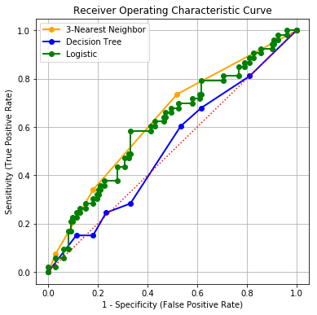
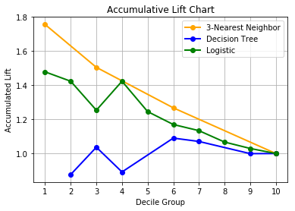
Learner Evaluation and Comparison

Slide 57
Feature Selection
Chapter 9 of the second edition of textbook
Feature Selection
Obviously non-informative (a.k.a., useless), business consideration, regulatory compliance, predictive strength for the label variable, etc.

Slide 58
Naïve Bayes
Chapter 10 of the second edition of textbook
Naïve Bayes is a simple special case of a Bayesian network
A Bayesian network is a graphical model that consists of two parts, <G, P>:
G is a directed acyclic graph (DAG) in which nodes represent random variables and arcs between nodes represent conditional dependence of the random variables.
P is a set of conditional probability distributions, one for each node conditional on its parents.
Structure Learning
Learn the G part
Parameter Learning
Learn the P part

Slide 59
Naïve Bayes Example
A house alarm from Russell and Norvig (2010). Artificial Intelligence: A Modern Approach, Third Edition. New Jersey: Pearson.
Your house has an alarm system against burglary. You live in a seismically active area, and the alarm system can be set off occasionally by an earthquake.
You have two neighbors, Mary and John, who do not know each other. If they hear the alarm, they might or might not call you.

Slide 60
Naïve Bayes Example

Slide 61
Naïve Bayes Example
In the house alarm example, observe that whether Mary or John calls is conditionally dependent only on the state of the alarm.
Based on the graph, the joint probability distribution of the events (E, B, A, M, and J) is Pr(E, B, A, M, J) = Pr(J|A) * Pr(M|A) * Pr(A|E, B) * Pr(B) * Pr(E).
The network structure together with the conditional probability distributions completely determines the Bayesian network model.

Slide 62
Naïve Bayes Example
Now consider this question: Suppose you are at work, the house is burglarized (B = True), there is no earthquake (E = False), your neighbor Mary calls to say your alarm is ringing (M = True), but neighbor John doesn’t call (J = False). What is the probability that the alarm went off (A = True)?
According to the Naïve Bayes graph, Pr(A = T|B = T, E = F, M = T, J = F) ≈ 0.99.

Slide 63
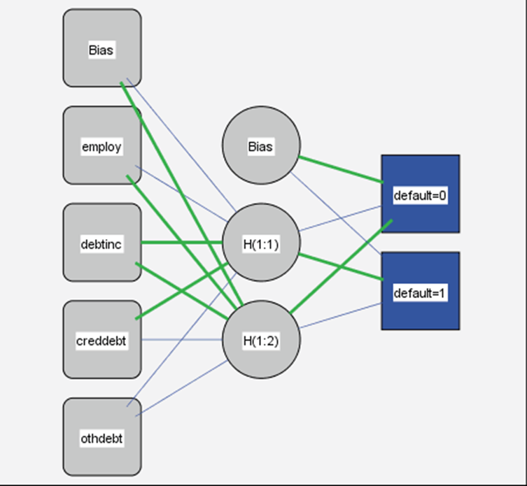
Neural Networks
Chapter 11 of the second edition of textbook
Multiple Layer Perceptron
A popular neural network structure
Backpropagation algorithm
The algorithm that estimates the weights (i.e., the parameters) in the structure

Slide 64
Support Vector Machines
Chapter 12 of the second edition of textbook
Kernel Machines
Builds a binary classifier (i.e., the label variable has only two possible values) by solving a convex optimization problem.
The optimization problem is to find the hyperplane (i.e., a linear function of the features) that maximizes the margin (i.e., the separation) between the two classes of the target.
The training data near the hyperplane are called the support vectors.
The result of training is the support vectors and the weights that are given to them.

Slide 65
Support Vector Machines
Both Line A and Line B can separate the two groups of observations.
However, Line A is preferred as it has a wider margin from either group of the observations.
If the new observation ( ) comes, it will be misclassified as the blue square using Line B, but correctly classified using Line A.

Slide 66
Combining Multiple Learners
Chapter 13 of the second edition of textbook
Bagging
Increase prediction accuracy by the bootstrap algorithm
Adaptive Boosting and Gradient Boosting
Increase prediction accuracy by giving more attention to observations that can improve accuracy but less attention to those that cannot.

Slide 67
Preparation For Week 2
Get the Machine Learning book
Get your Python environment ready
Run the Week 1 MyFirstDecisionTree.py
Read Chapter 1 and Chapter 2 of the Machine Learning book
Ask yourself:
Why do you need to read this chapter?
What problems can I apply the algorithms in this chapter?

